Slide 1



Customer Retention Data Analysis
Konatala Mohit
Intership-23 , ID-34

Slide 2

Abstract
Introduction
Descriptive Analysis
Data Visualization
Data cleaning and modifying
Feature Selection
Conclusion

Slide 3

Abstract
Data analysis on collected data of survey on Indian e-commerce shopping website that is to identifying the factor that influence the customer repeat purchase intention.

Slide 4

Introduction
In today’s digital era there has been boom in E-commerce and its market is still accelerating at a sky rocketing speed. E-commerce is a steppe platform for many rapidly evolving and growing companies to sell commodities. E-retailers expand their business by mean of increment in number of customers to their platform. For any E-retailer to be successful there are many factors to surge the sales but the key to the solution is very simple i.e. to satisfy the customer. Satisfying the customer leads to retaining them back to E-retail platform and the cycle of purchase is repeated. There have been many researches carried out to explore what exactly retention the customer and how to extract loyalty out of all the customers. There majorly five features that influence the success of an E-commerce, they are service and system quality, information quality and to sum it up trust and net benefit are the final pillar of a profound successful E-retailer. In this project exploratory analysis is done on the data collected from the survey of Indian customers regarding the e-commerce shopping

Slide 5

Exploratory Data Analysis
Objective:
Analysis of the data set and summarizing the factor that effect the customers recommendation regarding e-retail store.
Understanding the Data Via Descriptive analysis
Shape of the data: 269 row and 71 columns
All the data available is in ordinal form
Data is Imbalance

Slide 6
Checking for null values
Counting of number elements in each column
Checking the count of repeating individual element in each column of the data.
Descriptive analysis is used as it gives the basic value Insite of the data in our dataset.
It helps in organize the data and summarize the data while describing the characteristic of data.

Slide 7
Data Visualization
Data visualization is one simplest way to get a proper idea about the characteristics of the data just from vision. In much simpler words , we Visualize the descriptive stats of the data in pictorial format. Also the data characteristic are represented in eye soothing way
Identifying pattern, understanding is the data is more easier through visuals.

Slide 8
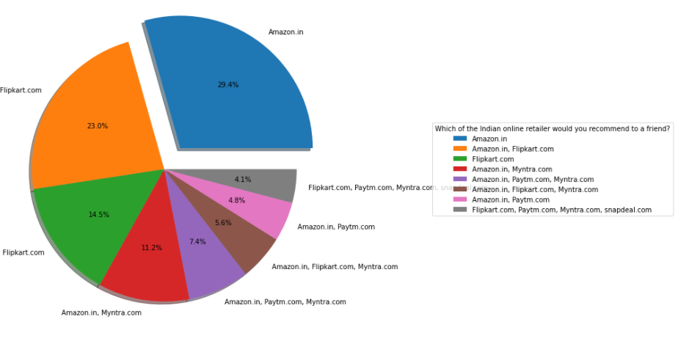
Target Variable :

Slide 9
Observation from Data Visualization:
Easy User Interface
Information of similar product highlighted with the current searched product also the seller information of the product.
Clear information of the product
.Loading and processing speed of the application or the website.
Convenient payment method and Customer Service and privacy
Net benefits and discounts. Return and Replacement policy
.Wide variety of products availability on the websiteand Value for money.

Slide 10
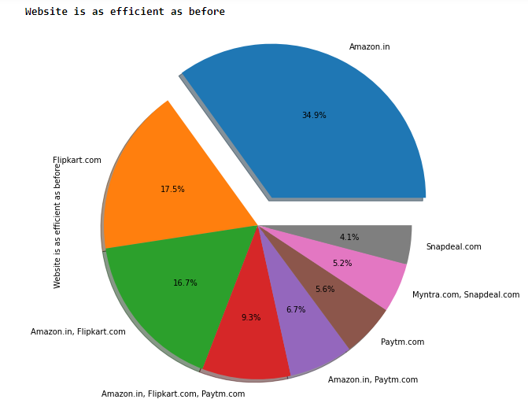
Independent variables influencing the target variable pie chart

Slide 11
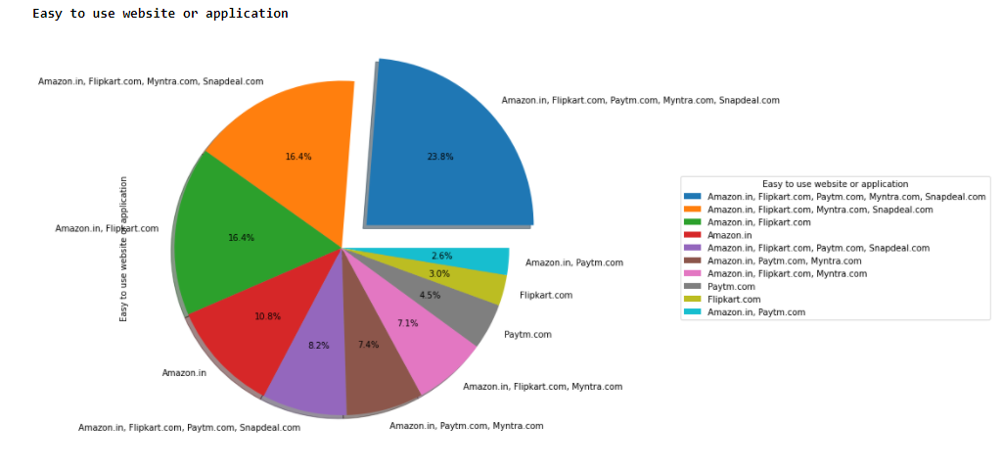

Slide 12
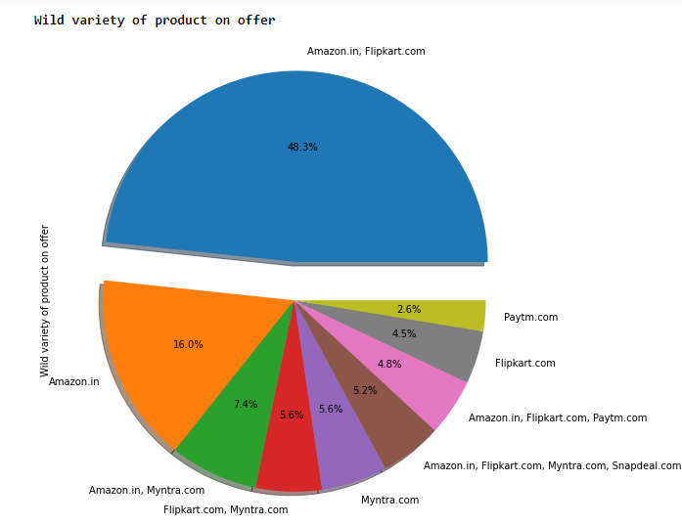

Slide 13
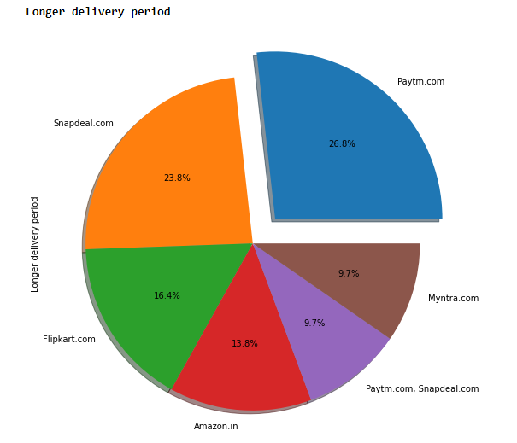

Slide 14
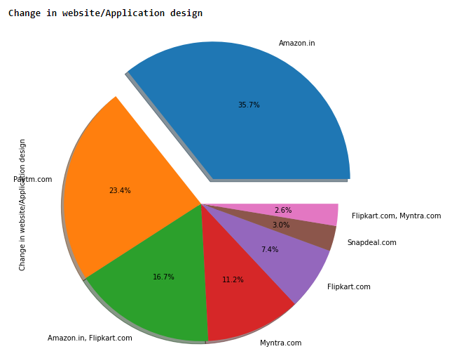

Slide 15
Cleaning the Data
Cleaning data is one of the most important procedure in data analysis i.e. detecting and modifying or removing the inaccurate data from the dataset so as improve data quality
Tasks in data cleaning:
Handling null values
Arresting outliers
Removing Skewness if required
Feature Selection and balancing the data

Slide 16
Observation:
No null values in the dataset
Data is free from outliers
Skewness is comparatively less
Feature Selection and Normalization:
Feature selection is done on the basis of corelation (also to remove multi-collinearity) with the target variable and to improve model training. Normalization to remove bias from the data while feeding it to ML.

Slide 17
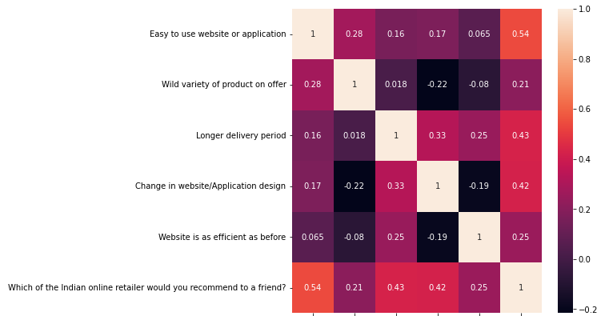
Co-relation chart after feature selection:

Slide 18
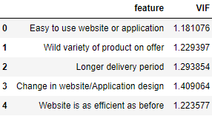
Variance Inflation Factor:
After Normalizing the data and feature selection VIF is used to cross check if there is any existence of multi-collinearity between the independent variable
Note :
VIF and Normalization should done only on independent variables i.e. after splitting the target data column.

Slide 19
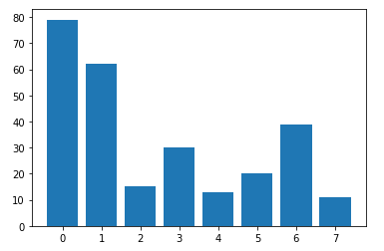
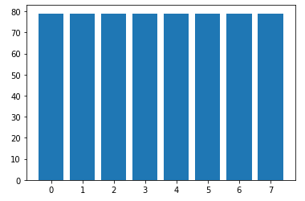
SMOTE analysis:
Synthetic Minority Oversampling Technique is used to balance the dataset and improve the model training process.
Before SMOTE
After SMOTE

Slide 20

Below the keys point in Summarizing the data analysis of customer retention data:
Size of the Dataset is size.
No missing values in the dataset.
Dataset contains ordinal data
Converted ordinal data into numerical data
.Dataset has no outliers
.Feature selection of independent data is done via heatmap and VIF value
.Separate features and prediction variables into two separate list.
Used SMOTE to oversample the data and balance it.

